Slide 1
Naíonáin 2021-22 Junior Infants

Slide 2
“Fás agus Foghlaim- Growing and Learning”

Slide 3
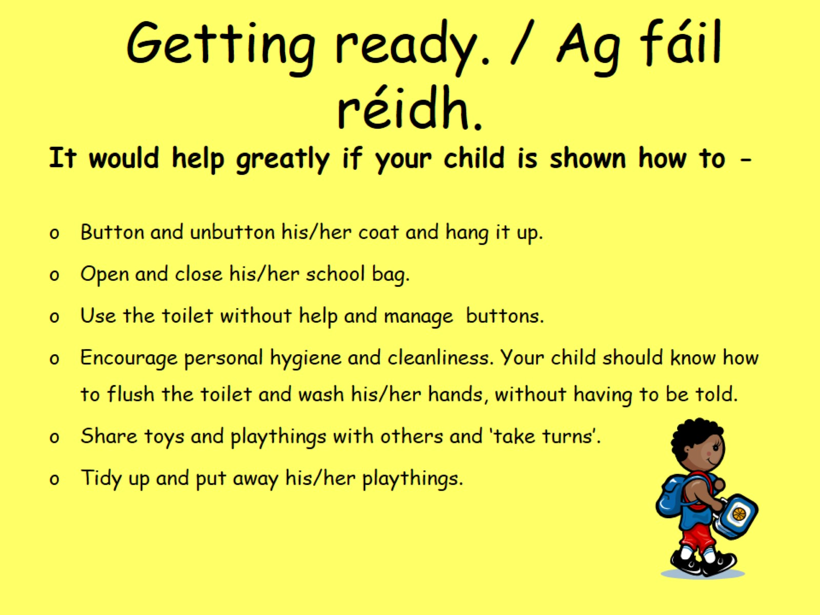
Getting ready. / Ag fáil réidh.

Slide 4
An éide scoile- school uniform- Please note that ANY navy school jumper/cardigan and grey polo or shirt is acceptable- does not have to have school crest. A navy tie may be worn if you decide to go with shirt instead of polo. ANY grey school trousers/skirt/pinafore are acceptable. Children may wear navy or dark grey tracksuit bottoms (PLAIN) on Fridays for P.E. Should you decide to order a crested jumper, details will be made available shortly on our school website www.scoilfhionain.ie

Slide 5
The Big day/ An Chéad lá

Slide 6
Ag Toiseacht /Starting off…

Slide 7
Text a Parent Text a parent allows the school to notify parents re any upcoming events or if there was an emergency closing. It is important to notify school if you change your number. Text a Parent app can be downloaded from the app store on your phone. Note: Text messages have to be kept very short due to cost per letter! So often the text will provide a link to an item on school website www.scoilfhionain.ie Abbreviations etc which may appear in texts: GRMA = Go raibh Maith Agat= Thank You Maidin Mhaith= good morning Dia Duit= hello

Slide 8
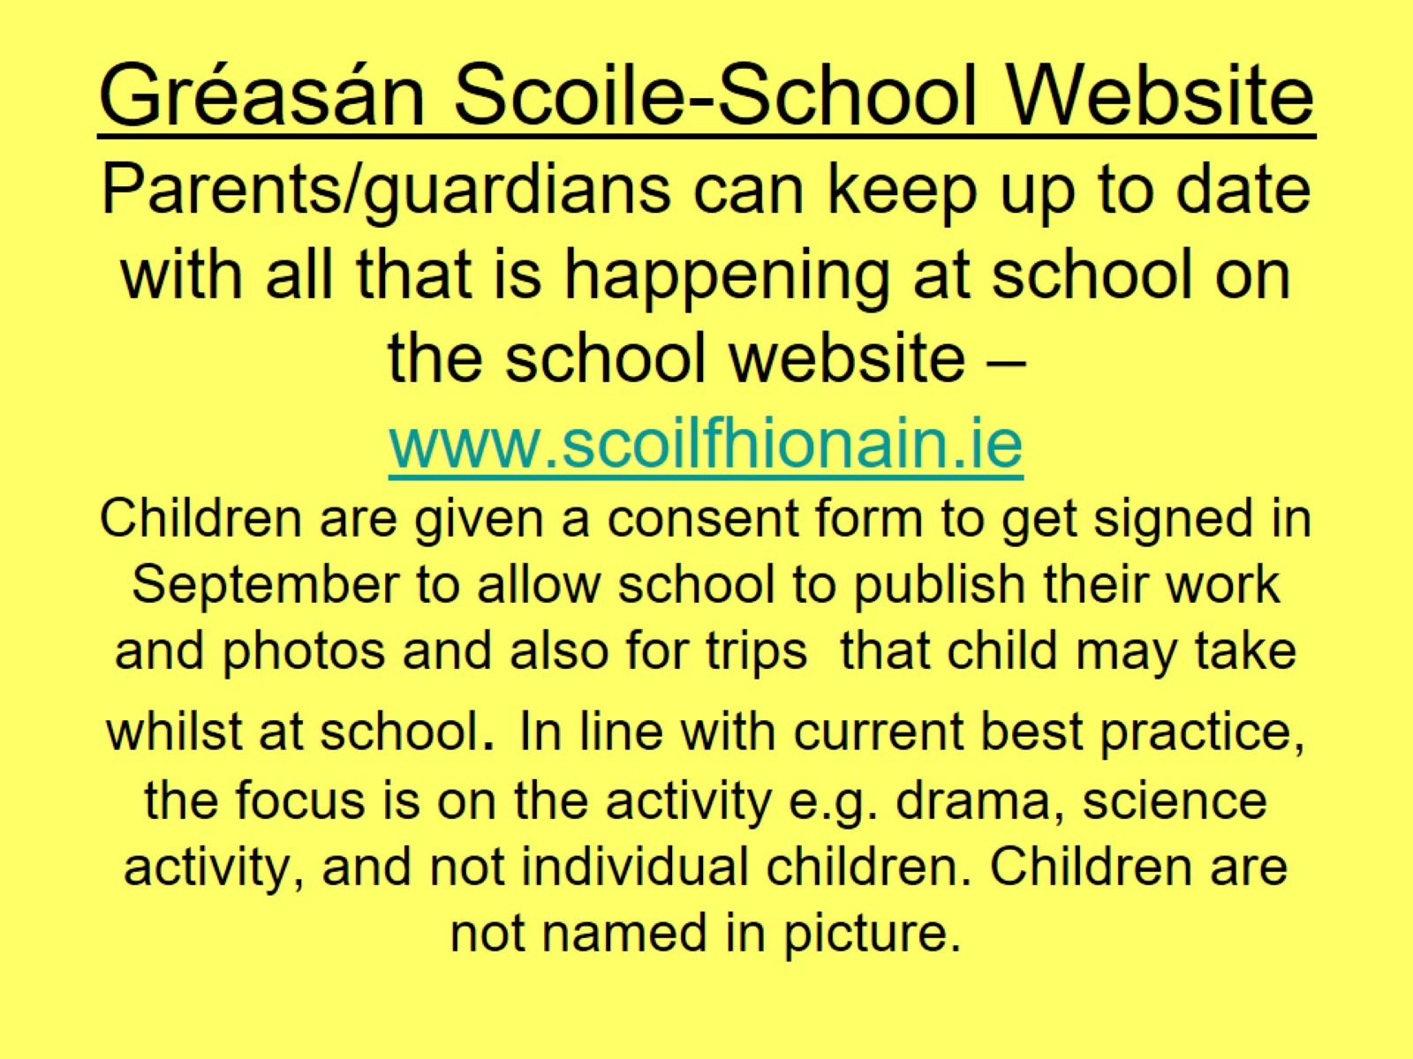
Gréasán Scoile-School Website Parents/guardians can keep up to date with all that is happening at school on the school website – www.scoilfhionain.ie Children are given a consent form to get signed in September to allow school to publish their work and photos and also for trips that child may take whilst at school. In line with current best practice, the focus is on the activity e.g. drama, science activity, and not individual children. Children are not named in picture.

Slide 9
Pre- Reading

Slide 10
Pre-Writing

Slide 11
The Curriculum

Slide 12
Scéim Aitheantais Scoileanna Gaeltachta From September, your child will join us on an exciting new journey as we develop our use of Gaeilge in school. Children pick up Gaeilge very quickly and we encourage you to speak Irish to your child, no matter how little. The benefits of having more than one language are outlined in letter you will have received.

Slide 13
New Child Protection Guidelines were issued in 2017 and they can be viewed on the school website. Teachers and principal are duty bound to report any concerns they have to TUSLA child and family agency. Concerns may be in the area of 1.child neglect 2. emotional abuse 3. physical abuse 4. sexual abuse

Slide 14
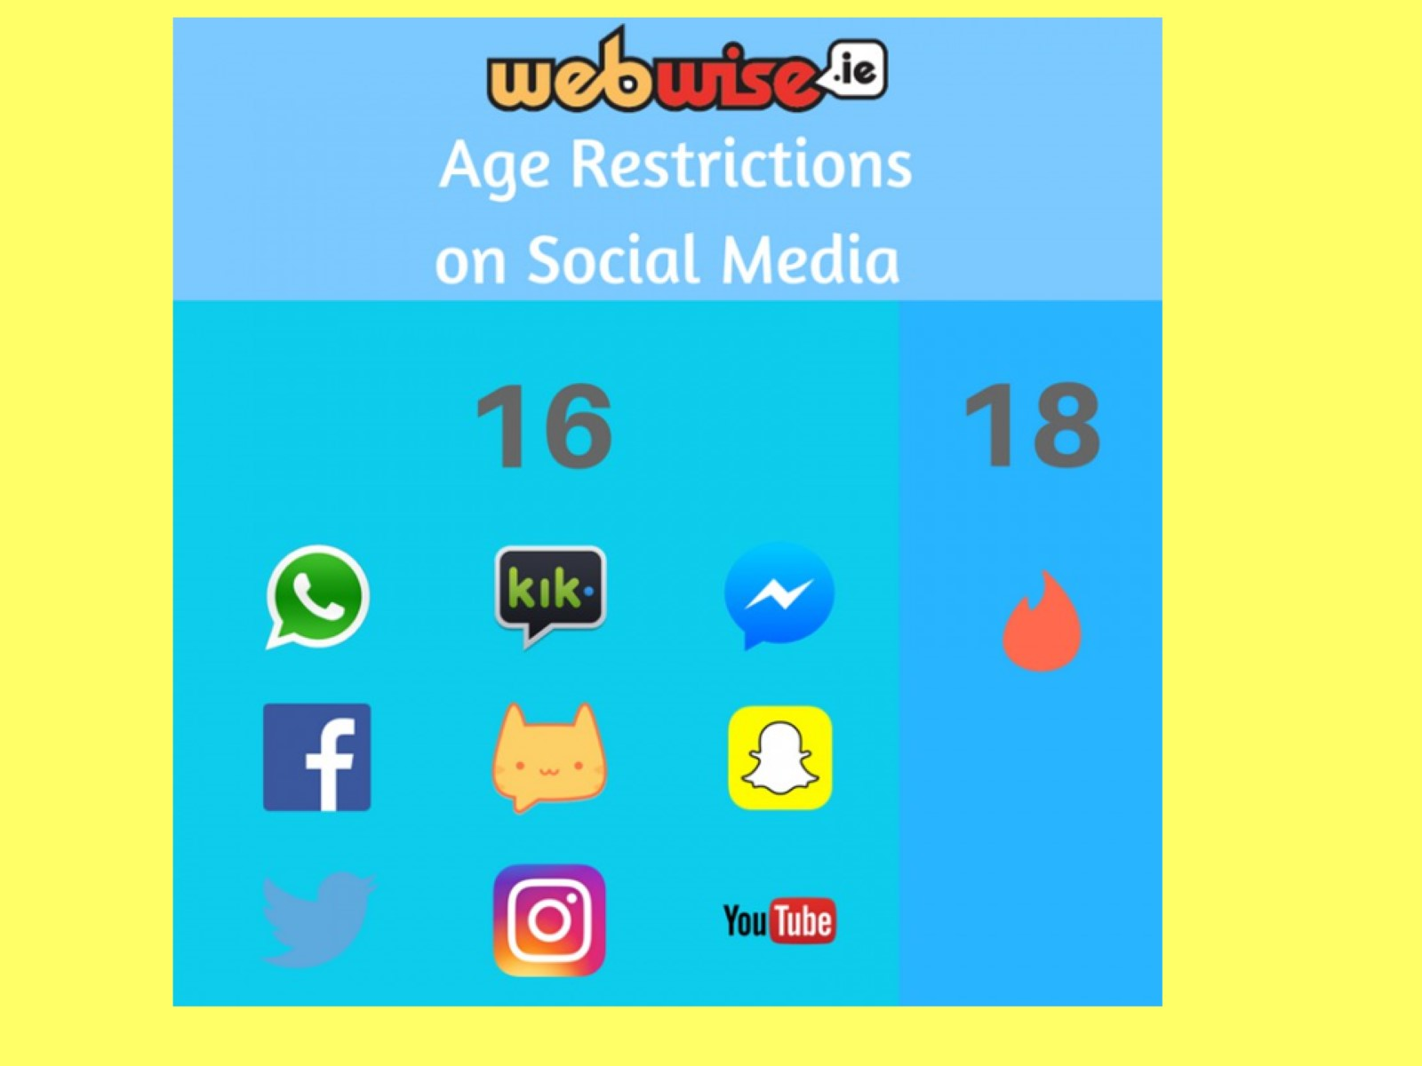

Slide 15
New Data Protection

Slide 16
Obair Bhaile-Homework

Slide 17
Curaclam Teanga/ Language Curriculum

Slide 18
Is scoil dhigíteach í Scoil Fhionáin- We are a digital school

Slide 20
Amanna Sosa- Breaks

Slide 21
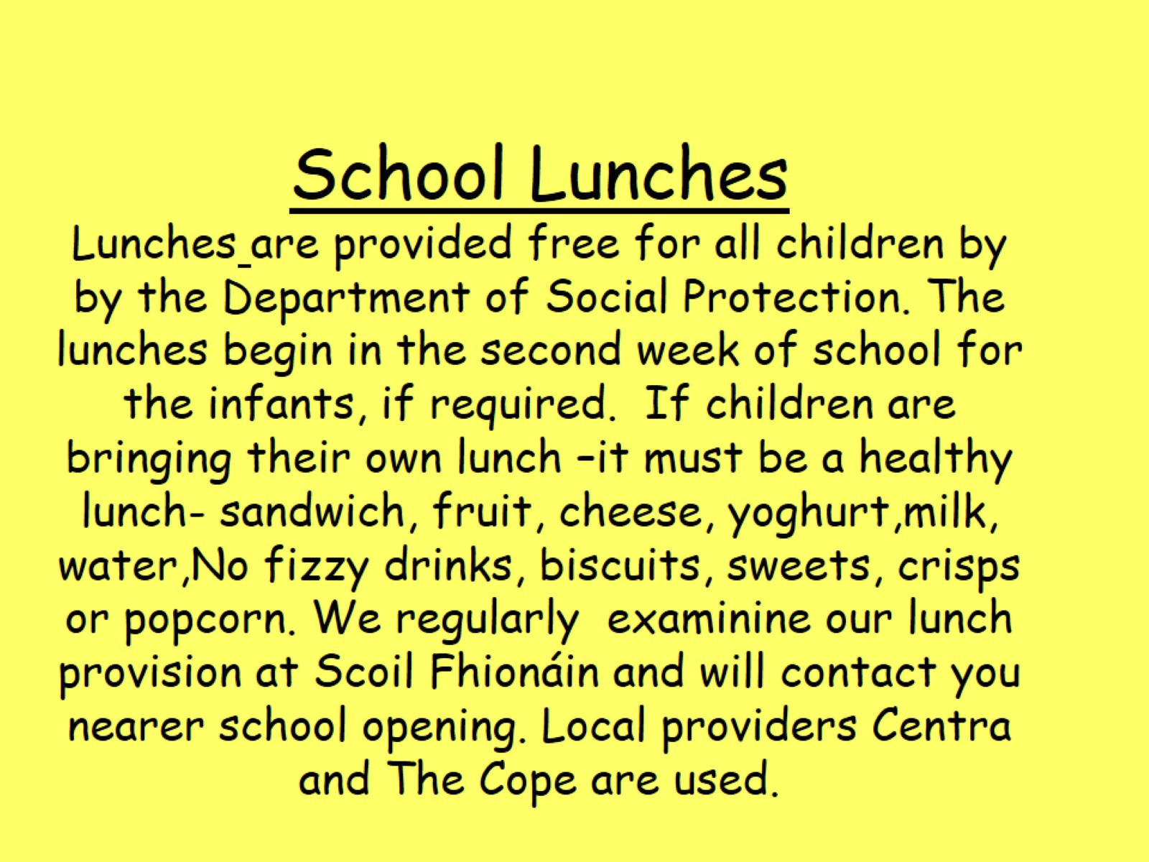
School Lunches Lunches are provided free for all children by by the Department of Social Protection. The lunches begin in the second week of school for the infants, if required. If children are bringing their own lunch –it must be a healthy lunch- sandwich, fruit, cheese, yoghurt,milk, water,No fizzy drinks, biscuits, sweets, crisps or popcorn. We regularly examinine our lunch provision at Scoil Fhionáin and will contact you nearer school opening. Local providers Centra and The Cope are used.

Slide 22
Ag dul Abhaile/ Going Home..

Slide 23
You Can help…

Slide 25
We work closely with HSE organisations such as Meitheal, parent Hub Donegal, which are programmes which help parents in the important work they do. Information is available in school about their courses. See Parent/guardians section on www.scoilfhionain.ie for further details.

Slide 26
Cúpla Pointe- A Few Points If your child has any medical condition or allergies please let teacher / principal know. Please check hair regularly and inform school if there is a problem- long hair should be tied back at school. Birthday invitations must not be distributed in class- it is upsetting for children who don’t get an invitation!

Slide 27
“Mol an Óige agus Tiocfaidh sí” Children flourish when they are praised. This is our belief at Scoil Fhionáin. It is important that school and home work together for the good of the child. Go raibh maith agat!

